Slide 1


Slide 2


Slide 3


Slide 4


Slide 5
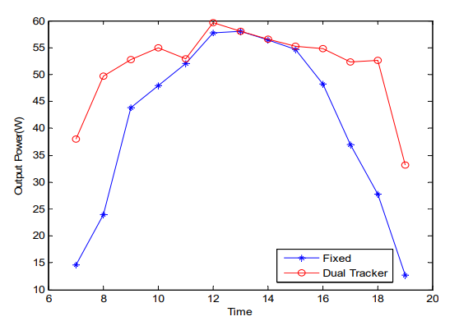
These are the data observed that clearly shows power output of dual axis tracker increases with time in comparison to static panels.
Link: http://www.enggjournals.com/ijet/docs/IJET13-05-02-213.pdf

Slide 6


Slide 7


Slide 8
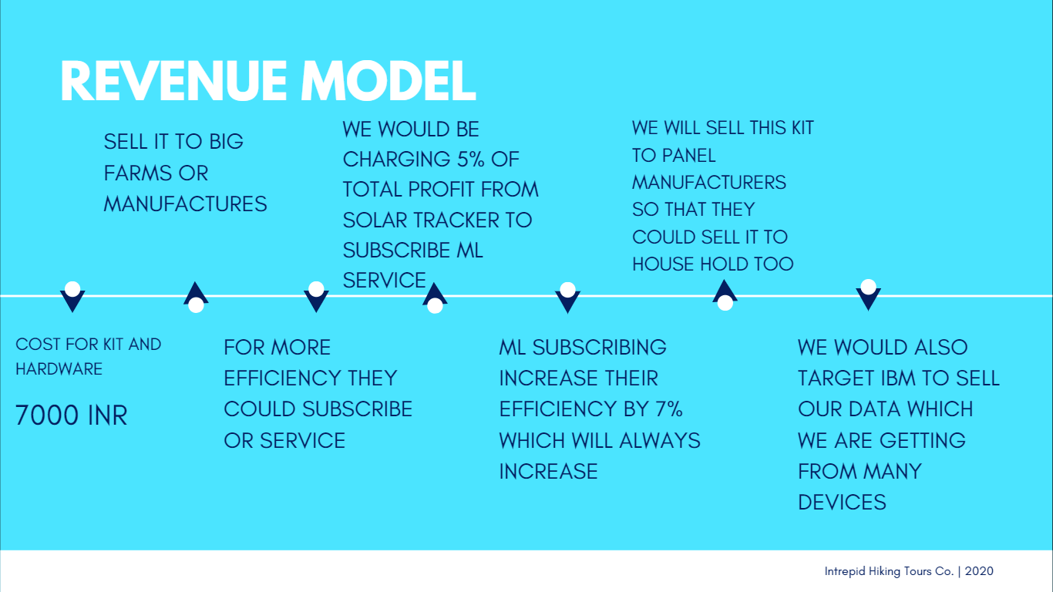

Slide 9


Slide 10


Slide 11
